Slide 1
Chapter 9
Introduction To Data-Link Layer

Slide 2
Chapter 9: Outline
9.1 INTRODUCTION
9.2 LINK-LAYER ADDRESSING

Slide 3
Chapter 9: Objective
The first section introduces the data-link layer. It starts with defining the concept of links and nodes. The section then lists and briefly describes the services provided by the data-link layer. It next defines two categories of links: point-to-point and broadcast links. The section finally defines two sub-layers at the data-link layer that will be elaborated on in the next few chapters.
The second section discusses link-layer addressing. It first explains the rationale behind the existence of an addressing mechanism at the data-link layer. It then describes three types of link-layer addresses. The section discusses the Address Resolution Protocol (ARP), which maps the addresses at the network layer to addresses at the data-link layer.

Slide 4
9.1 Introduction
Internet
  The Internet is a combination of networks glued together by connecting devices (routers or switches).
  If a packet is to travel from a host to another host, it needs to pass through these networks.

Slide 5
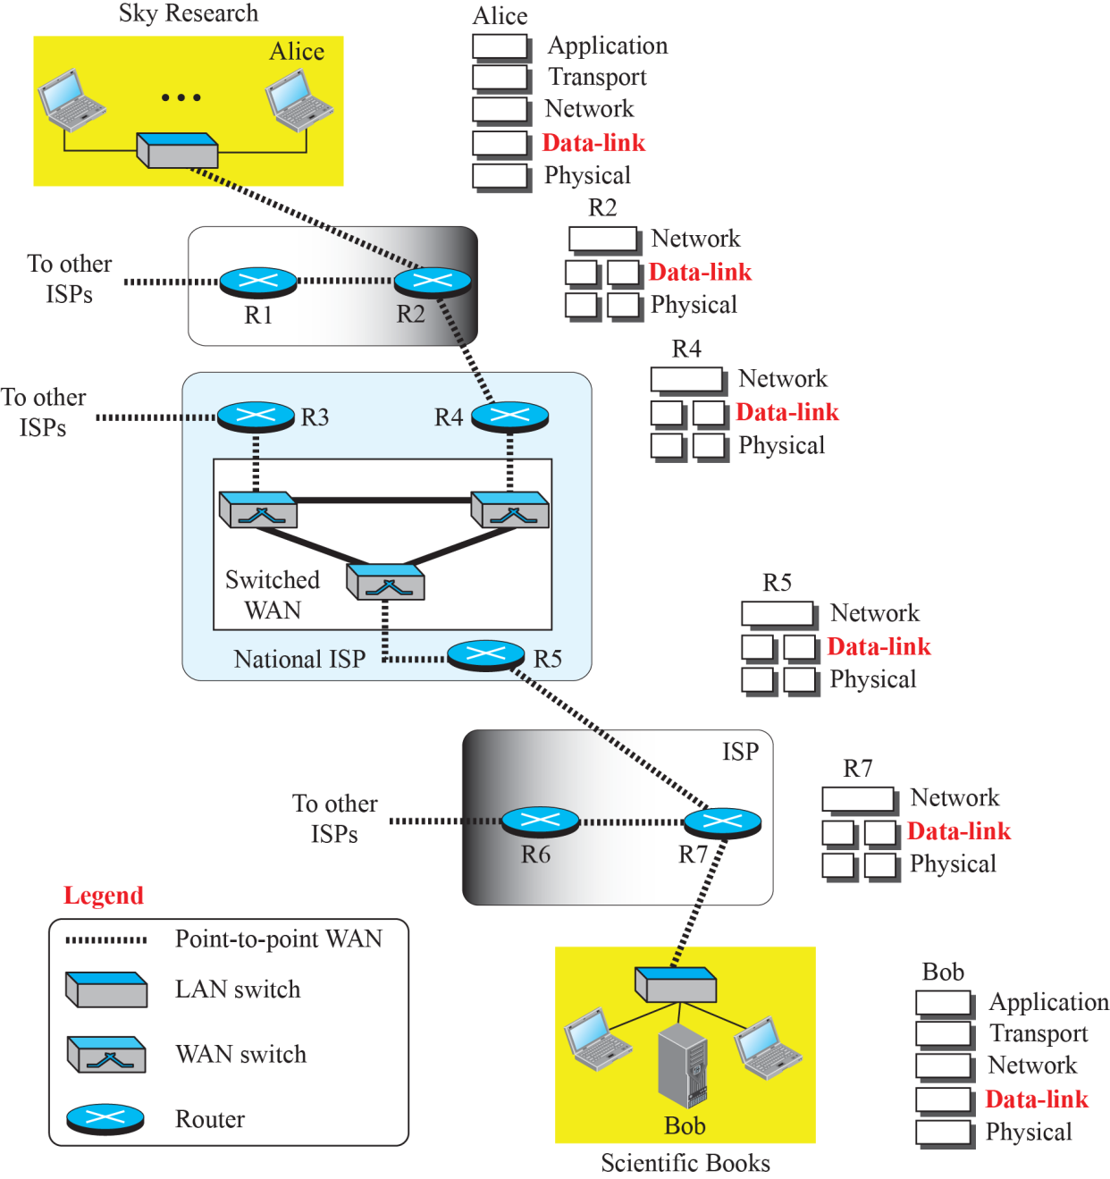
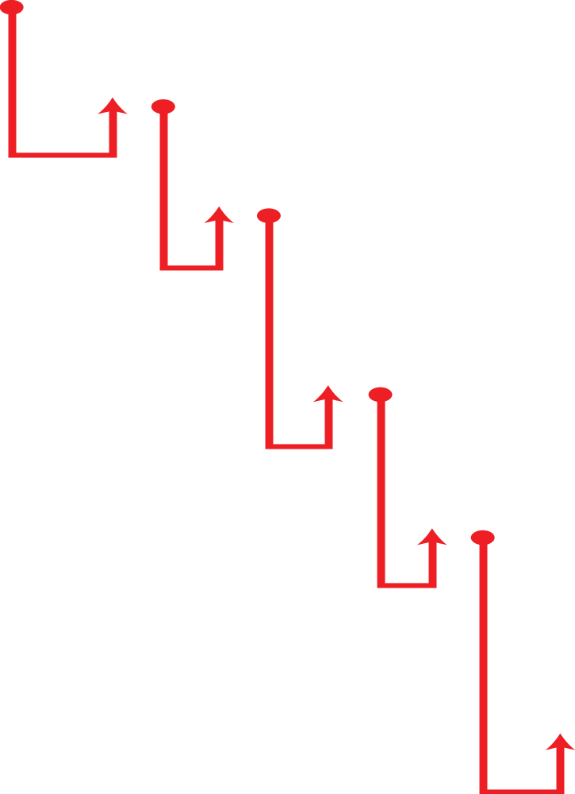
Figure 9.1: Communication at the data-link layer

Slide 6
9.1.1 Node and Link
Communication at the data-link layer is node-to-node.
  A data unit from one point in the Internet needs to pass through many networks (LANs and WANs) to reach another point.
LANs and WANs are connected by routers.
  The two end hosts and the routers are referred as nodes.
  the networks in between are referred as links.

Slide 7
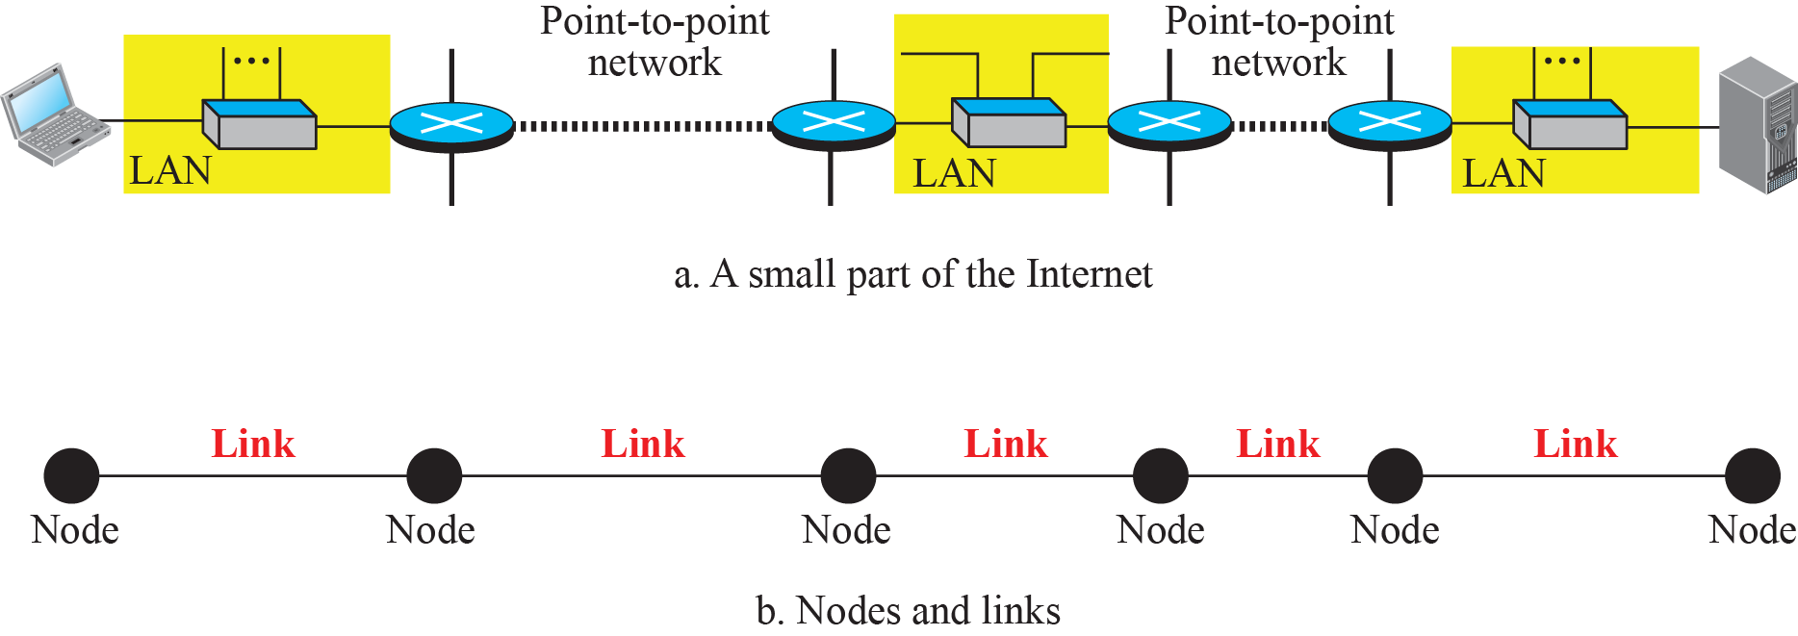
9.1.1 Node and Link
Nodes and Links
Figure 9.2 is a simple representation of links and nodes when the path of the data unit is only six nodes.

Slide 8
9.1.2 Services
The data-link layer is located between the physical and the network layers.
  The data-link layer provides services to the network laye
  It receives services from the physical layer.
The services provided by the data-link layer :
  Framing : Encapsulation the datagram in Frame.
  Flow Control : The rate of produced frames should be controlled according to the rate of consumed frames.
  Error Control : The error needs first to be detected. And it needs to be corrected or discarded and retransmitted.
  Congestion Control : A link may be congested with frames. Most data-link layer protocol do not directly use congestion control.

Slide 9

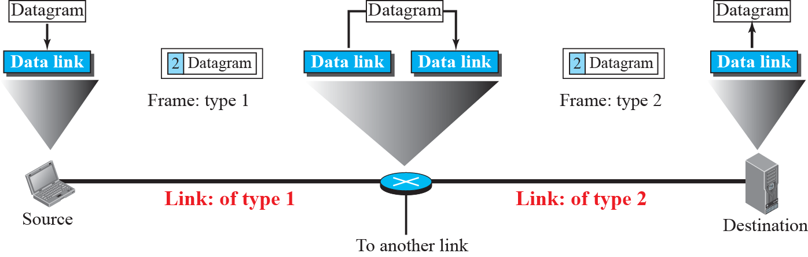
9.1.2 Services
A communication with only three nodes

Slide 10
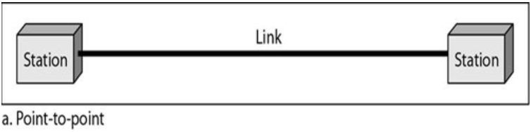
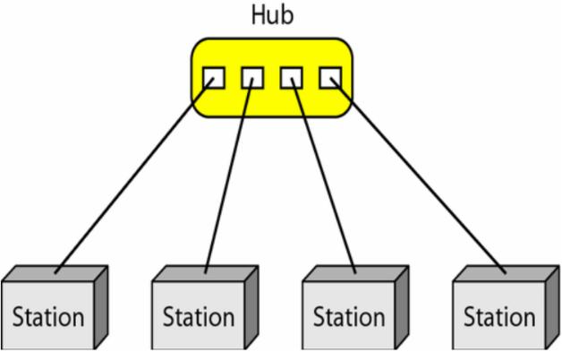
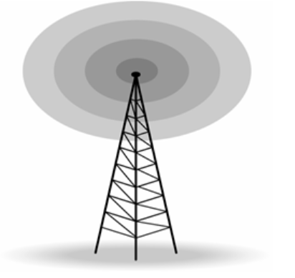
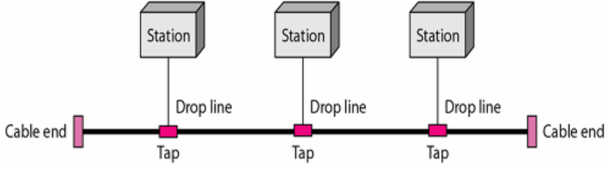
9.1.3 Two Categories of Link
The data-link layer controls how the medium is used.
  Point-to-Point Link uses the whole capacity of the medium.
  Broadcast Link uses only part of the capacity of the link.

Slide 11
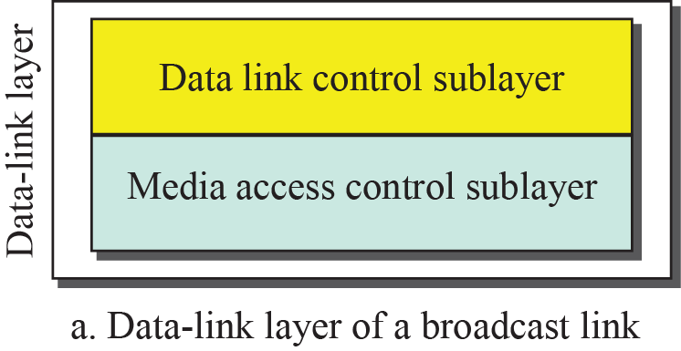
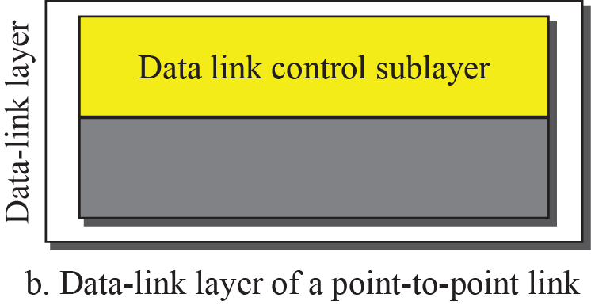
9.1.4 Two Sublayer of Datalink Layer
We can divide the data-link layer into two sub-layers: Data Link Control and Media Access Control.
Data Link Control (DLC)
  It deals with all issues common to both point-to-point and broadcast links
Media Access Control (MAC)
  It deals only with issues specific to broadcast links

Slide 12
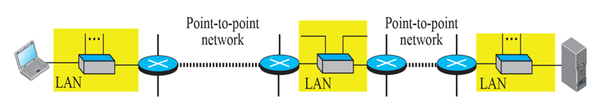
9.2 Addressing of Datalink Layer
IP addresses is the identifiers at the network layer.
  The IP addresses in a packet should not be changed.
In the Internet, we cannot make a packet reach its destination using only IP addresses.
  The source and destination IP addresses define the two ends.
  IP addresses cannot define which links the packet should pass through.

Slide 13
9.2 Addressing of Datalink Layer
When a datagram passes from the network layer to the data link layer,
  the datagram will be encapsulated in a frame,
  and two link-layer addresses are added to the frame header.
Other terms of link-layer address
  Link Address, Physical Address, MAC Address, Ethernet Address, Hardware Address, Adaptor Address …

Slide 14
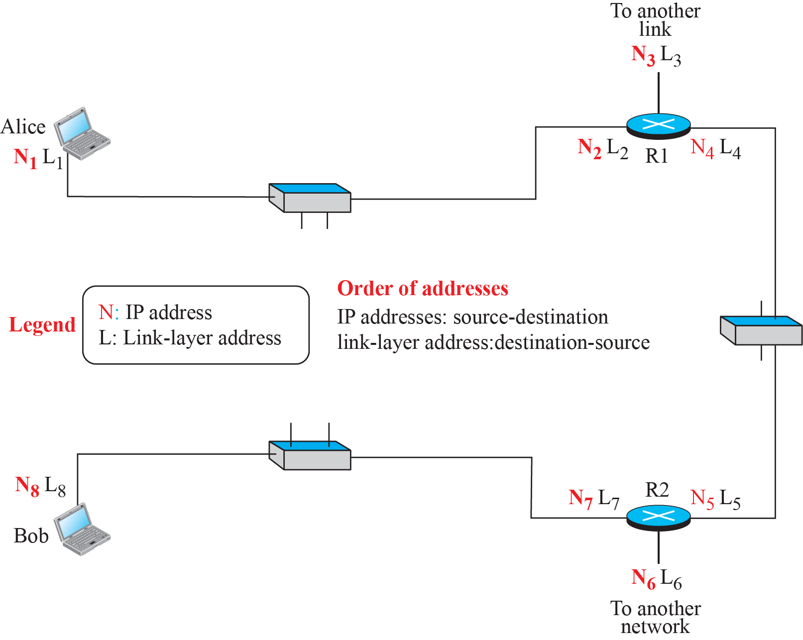
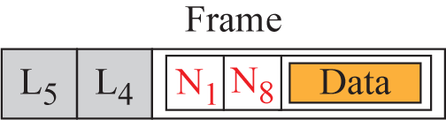
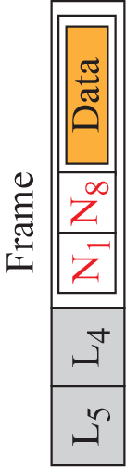
9.2 Addressing of Datalink Layer
IP and link-layer addresses in a small internet
  Link layer addresses are changed from link to link every time the frame moves one link to another.
L₂
L₁
L₈
L₇

Slide 15
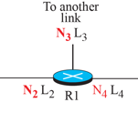
9.2.1 Three Types of addresses
Some link-layer protocols define three types of addresses: unicast, multicast, and broadcast.
  Unicast Address:
    Unicasting means one-to-one communication.
    Each host or each interface of a router is assigned a unicast address.
  Multicast Address :
    Multicasting means one-to-many communication.
    The jurisdiction is local (inside the link).
  Broadcast Address :
    Broadcasting means one-to-all communication.
    The frame is sent to all entries in the link.

Slide 16
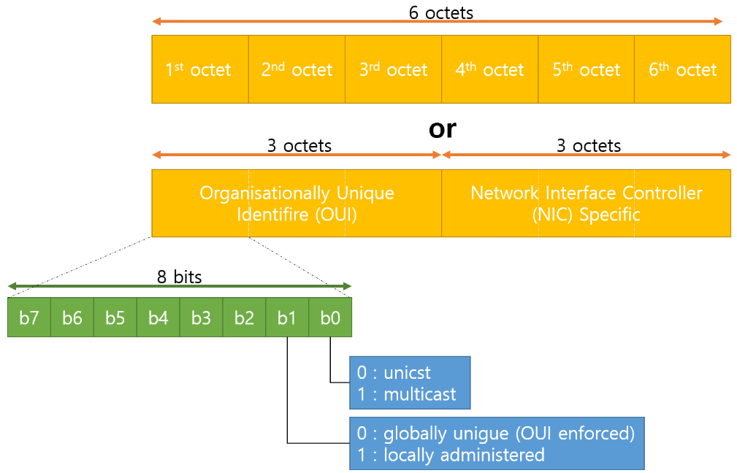
9.2.1 Three Types of addresses
Datalink Layer Address
  The unicast datalink layer addresses are 6byte (2⁴⁸ addresses).
  They are presented as 12 hexadecimal digits separated by colons(:).

Slide 17
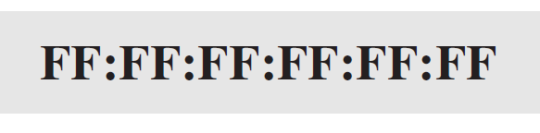
9.2.1 Three Types of addresses
Unicast Datalink Layer Address
  The second digit is even.
Multicast Datalink Layer Address
  The second digit is odd.
Broadcast Datalink Layer Address
  48 bits are all 1s.
A2:34:45:11:92:F1
Error in Text.
A3:34:45:11:92:F1

Slide 18
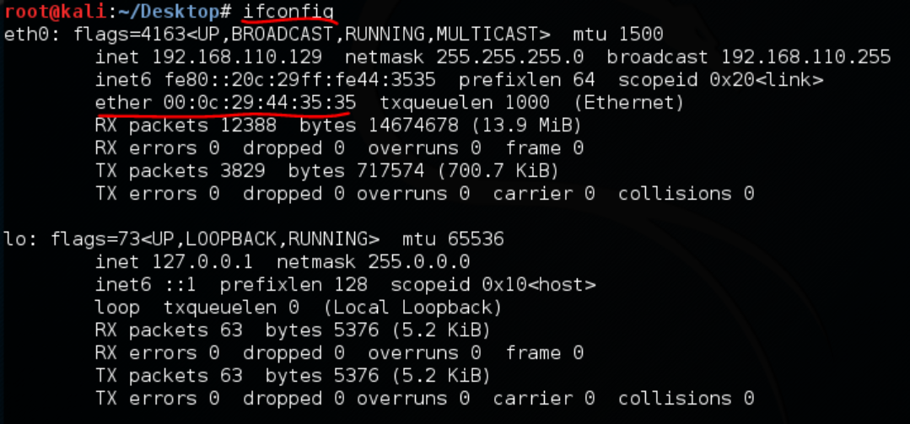
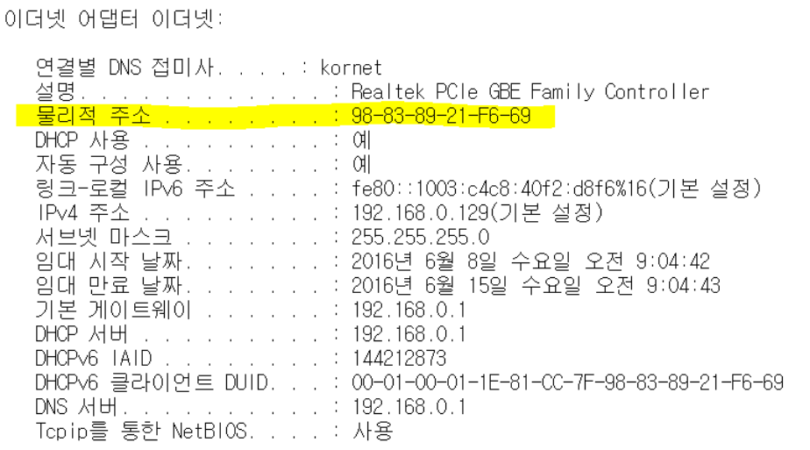
9.2.1 Three Types of addresses
TO see MAC Address in cmd window
  Window OS : "ipconfig -all"
  Linux OS : "ifconfig -all"

Slide 19
9.2.2 Address Resolution Protocol(ARP)
Anytime a node has an IP datagram to send to another node in a link, it has the IP address of the receiving node.
  The IP address of the next node is not helpful in moving a frame through a link.
  We need the link-layer address of the next node.
Address Resolution Protocol
  ARP maps the IP address to the corresponding link-layer address, and passes it to the data-link layer.
  ARP belongs to the network layer.

Slide 20
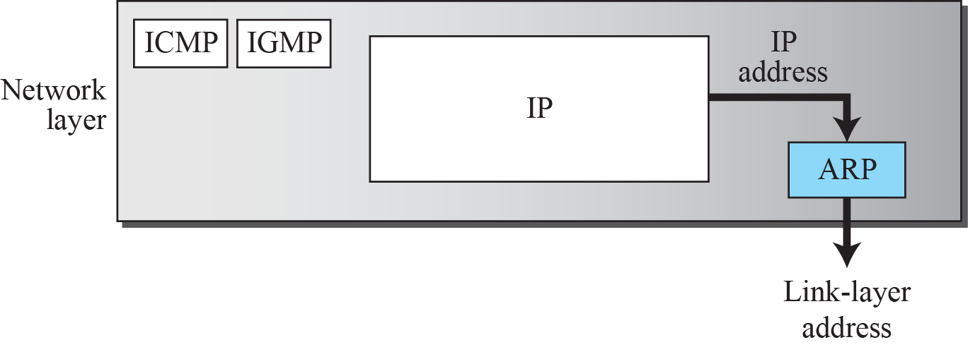
9.2.2 Address Resolution Protocol(ARP)
Position of ARP in TCP/IP protocol

Slide 21
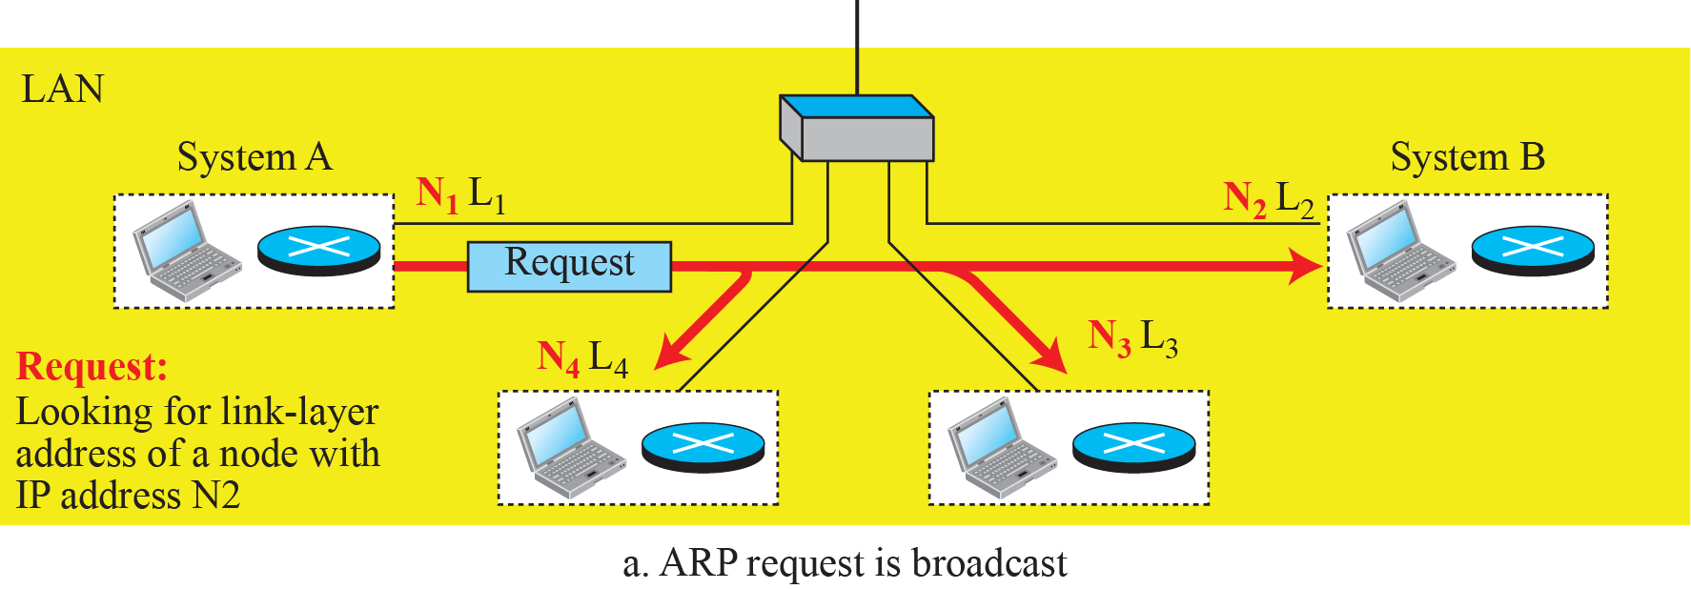
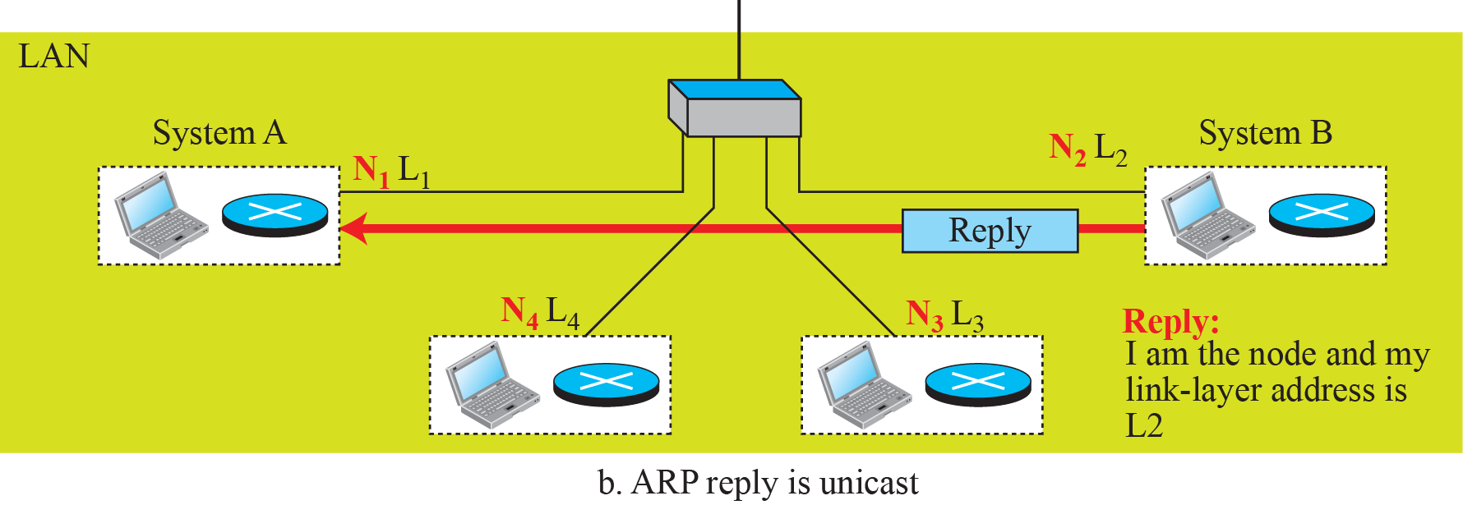
9.2.2 Address Resolution Protocol(ARP)
ARP operation

Slide 22
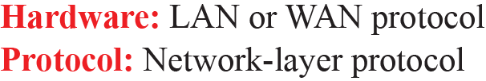
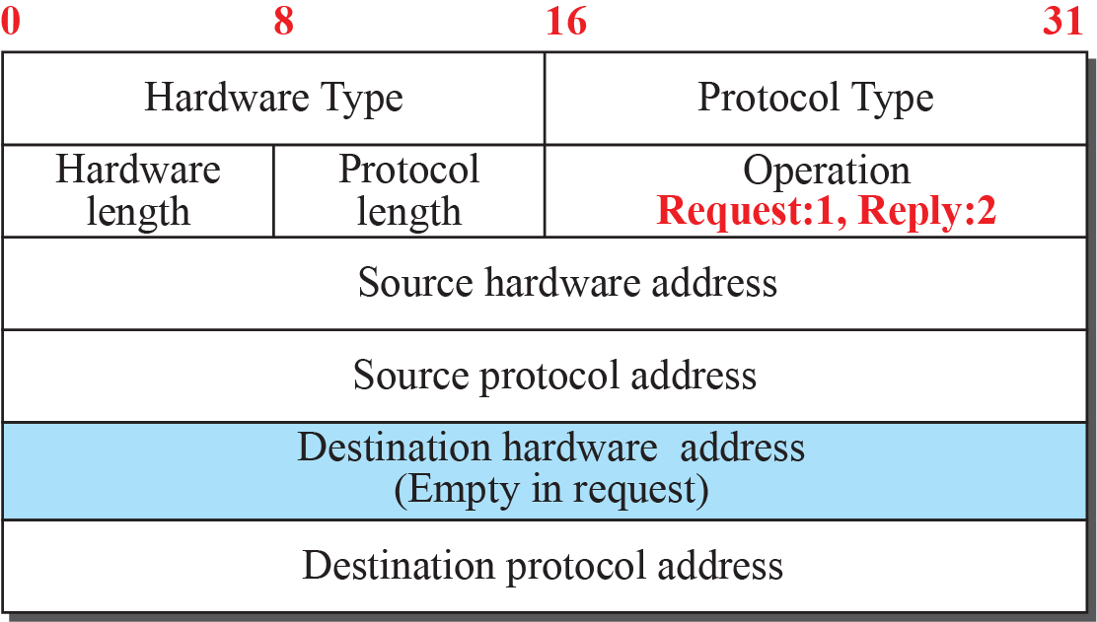
9.2.2 Address Resolution Protocol(ARP)
ARP packet : 28Bytes
Ethernet : 1
IPv4 0800₍₁₆₎
Address
Address
(bytes)
(bytes)
6 byte
Link-layer address
4 byte
Network layer address
6 byte
Link-layer address
4 byte
Network layer address

Slide 23
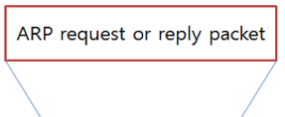
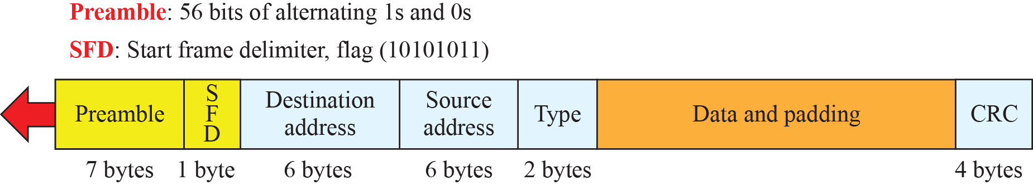
9.2.2 Address Resolution Protocol(ARP)
ARP Packet is encapsulated in to frame in data link layer.
Ethernet Frame
  The length of a frame in Ethernet is 64 bytes (512bit).
  The minimum length of data is 46 bytes.
  If data is less than 46 bytes,
  padding (0) is added.
46 bytes

Slide 24
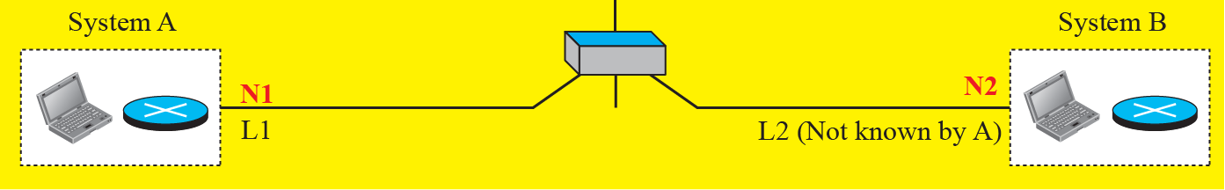
9.2.2 Address Resolution Protocol(ARP)
Example 9.4
A host has IP address N1 and MAC address L1 has a packet to send.
Another host has IP address N2 and physical address L2 (which is unknown to the first host).
The two hosts are on the same network.
The next slide shows the ARP request and response messages.

Slide 25
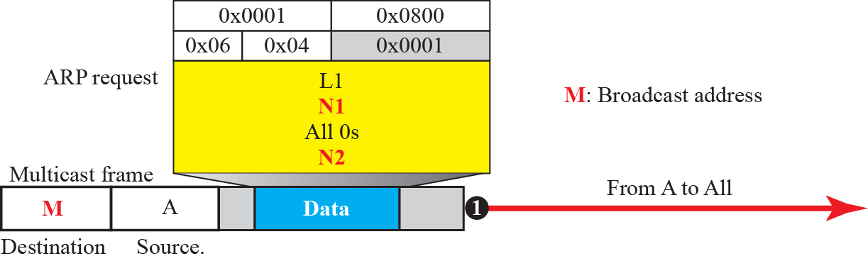
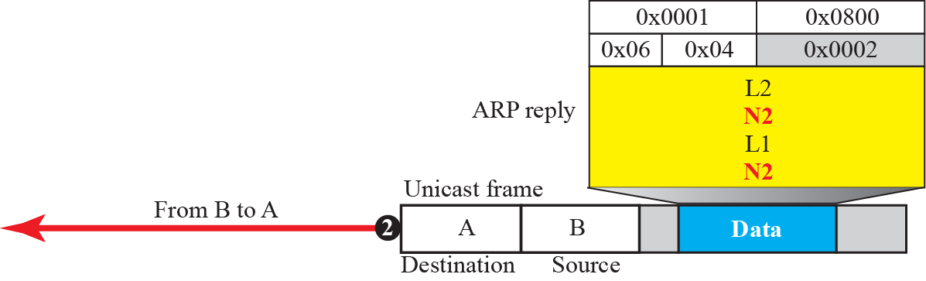
9.2.2 Address Resolution Protocol(ARP)
Example 9.4
To know B’s MAC address,
A broadcasts the ARP Request packet.
Only B sends the ARP Reply packet with it’s MAC address
N1

Slide 26
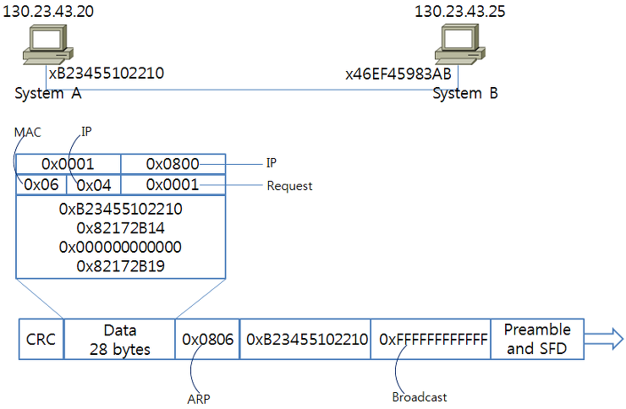
9.2.2 Address Resolution Protocol(ARP)
ARP Request Packet

Slide 27
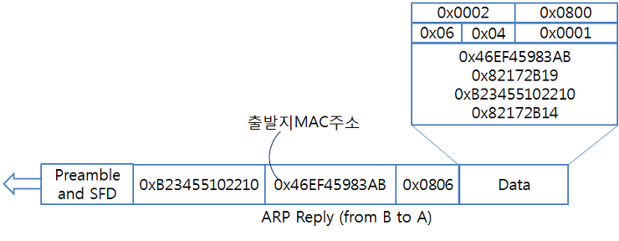
9.2.2 Address Resolution Protocol(ARP)
ARP Reply Packet
1
2

Slide 28
9.2.2 Address Resolution Protocol(ARP)
ARP Caching
  If system A gets link-layer address of system B using ARP, system A stores the address to its cache memory.
  The address in system A’s ARP cache is stored for 20 minutes.
  system A uses this cache information to sends frames to system B.

Slide 29
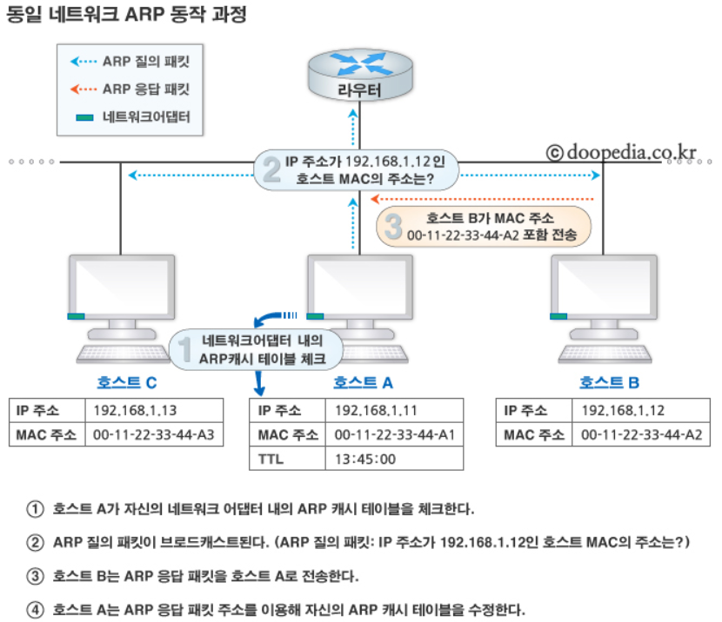
9.2.2 Address Resolution Protocol(ARP)

Slide 30
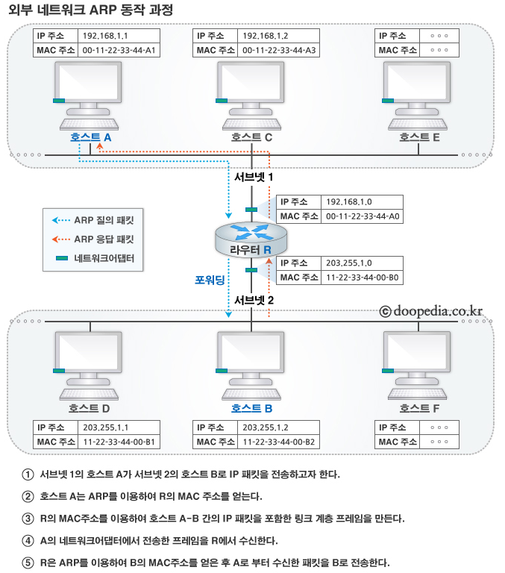
9.2.2 Address Resolution Protocol(ARP)

Slide 31
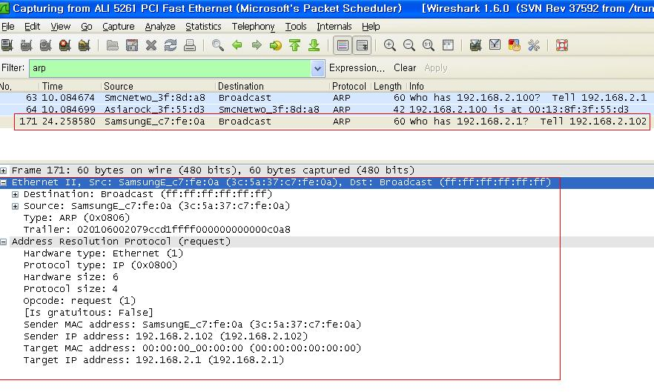
9.2.2 Address Resolution Protocol(ARP)
ARP Request Packet Capture - Wireshark

Slide 32
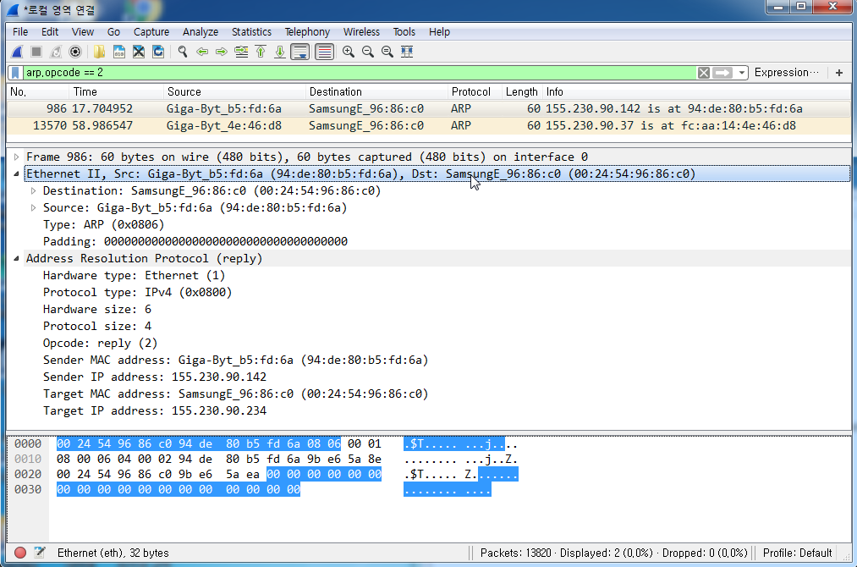
9.2.2 Address Resolution Protocol(ARP)
ARP Reply Packet Capture - Wireshark

Slide 33
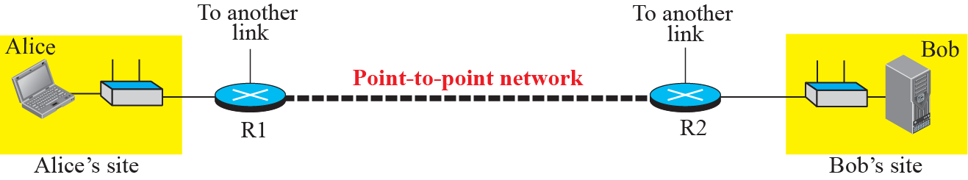
9.2.3 Communication Example
How communication is done at the data-link layer and how link-layer address are found?
The Internet for our example

Slide 34
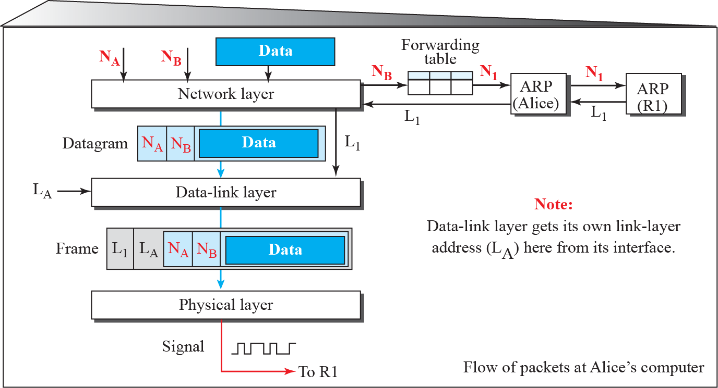
9.2.3 Communication Example
Flow of packets at Alice site
N: Network-layer address
L : Link-layer address
N_{A}
N₁
N₂
N₃
N₄
N_{B}
L_{A}
L₁
L₂
L₃
L₄
L_{B}

Slide 35
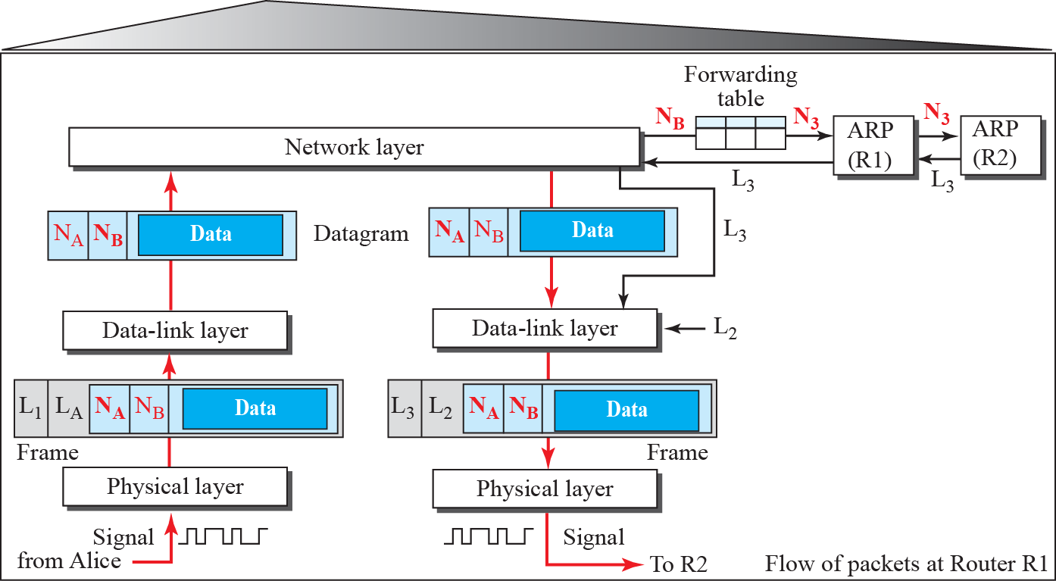
9.2.3 Communication Example
Flow of activities at router R1
N: Network-layer address
L : Link-layer address
N_{A}
N₁
N₂
N₃
N₄
N_{B}
L_{A}
L₁
L₂
L₃
L₄
L_{B}

Slide 36
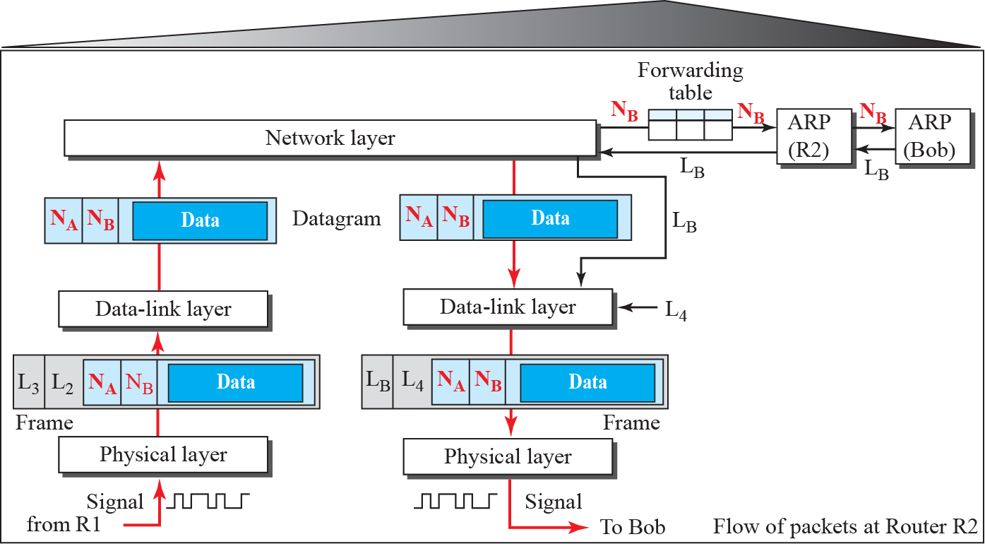
9.2.3 Communication Example
Flow of activities at router R2
N: Network-layer address
L : Link-layer address
N_{A}
N₁
N₂
N₃
N₄
N_{B}
L_{A}
L₁
L₂
L₃
L₄
L_{B}

Slide 37
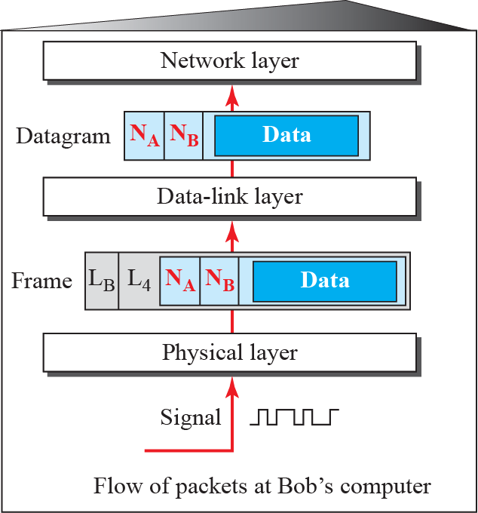
9.2.3 Communication Example
Activities at Bob’s site
N: Network-layer address
L : Link-layer address
N_{A}
N₁
N₂
N₃
N₄
N_{B}
L_{A}
L₁
L₂
L₃
L₄
L_{B}

Slide 38

9.3 Summary
Internet is made of many hosts, networks, and connection devices such as routers.
Data-link layer is responsible for the creation and delivery of a frame to another node, along the link.
Two types of addressing
  The end-to-end addressing
  The link-layer addressing
ARP was devised to map IP address to its link-layer address

